Slide 1

Welcome to Principal® EASE
Help your employees see a better retirement with
a well-designed and practical Pooled Employer Plan
Expect more. Do less.
For financial professional and plan sponsor use only.
PQ12765F-02 | 2924614-052023 | 05/2023

Slide 2
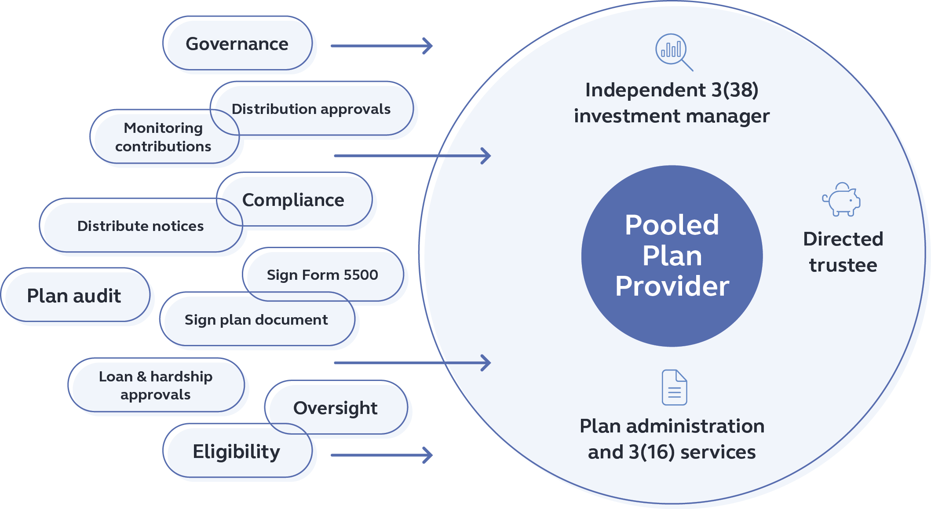
Why consider a pooled employer plan (PEP)?
Added expertise
Rely on experienced professionals
Shifting employer responsibility to the PEP
Saves time
Free up you and your staff
Reduces risk
Shift risk to designated fiduciaries along with fiduciary tasks
The decision to delegate to and ongoing monitoring of the Pooled Plan Provider (PPP) and 3(38) investment manager is the fiduciary responsibility of the adopting employer.
For financial professional and plan sponsor use only.
PQ12765F-02 | 2924614-052023 | 05/2023
Notes:
A PEP is designed with the intent to increase efficiencies, reduce plan administrative burdens on employers, manage costs more effectively, and help improve retirement outcomes for employees.
Outsourcing responsibilities to a PEP can help limit administrative and fiduciary involvement by:
Providing added expertise—Rely on experienced retirement plan professionals with tailored knowledge and skills for plan administrative service and investment management
Helping save time—Free up valuable employees to focus on their jobs, and owners can focus on their business
Reducing risk—Shift risk to designated fiduciaries along with those related plan fiduciary tasks

Slide 3

Benefits of a PEP
What's in it for you?
Professionals serve as the:
Named Fiduciary/Plan Administrator
Plan’s Trustee
Investment Fiduciary
This structure means:
You don’t file an individual Form 5500 anymore
You don’t sign off on plan loans or distributions
No individual Plan Annual Audit
The Pooled Plan Provider (PPP) ensures participant required annual notices are sent
The decision to delegate to and ongoing monitoring of the Pooled Plan Provider (PPP) and 3(38) investment manager is the fiduciary responsibility of the adopting employer.
For financial professional and plan sponsor use only.
PQ12765F-02 | 2924614-052023 | 05/2023
Notes:
What may motivate you to consider a PEP?
You’re not the Named Fiduciary/Plan Administrator
You’re not the Plan’s Trustee
You’re not the Investment Fiduciary
You don’t file a Form 5500 anymore
You don’t sign plan loans or distributions
No individual plan annual audit
The Pooled Plan Provider (PPP) ensures participant required annual notices are sent
You do need to know the decision to delegate to and ongoing monitoring of the Pooled Plan Provider (PPP) and other services provided is the fiduciary responsibility of the adopting employer.

Slide 4




Principal® EASE
Industry professionals working together
Principal is the Pooled Plan Provider (PPP) and recordkeeper. As PPP, we are the plan sponsor and designated by the terms of the plan as the 3(16) plan administrator and named fiduciary.
Wilshire
3(38) Investment
Fiduciary
Wilshire Advisors LLC (Wilshire®) is the 3(38) investment fiduciary responsible for the selection and ongoing monitoring of the plan’s investment lineup.
Adopting Employers
Pooled Plan Provider
3(16) Plan Fiduciary
Recordkeeper
PTC
Directed
Trustee
National Benefit Services, LLC (NBS) provides plan administration and 3(16) services under the direction and oversight of Principal.
Principal Trust Company® (PTC) is directed trustee and oversees the monitoring of timely plan contributions to the PEP.
NBS
Plan administration
& 3(16) services
Wilshire and National Benefits Services are not affiliates of any member of the Principal Financial Group.
The decision to delegate to and ongoing monitoring of the Pooled Plan Provider (PPP) and 3(38) investment manager is the fiduciary responsibility of the adopting employer.
For financial professional and plan sponsor use only.
PQ12765F-02 | 2924614-052023| 05/2023
Notes:
Careful thought has gone into designing this efficient PEP structure – Principal® EASE:
Principal as pooled plan provider is the plan sponsor and is designated by the terms of the plan as the 3(16) plan administrator and named fiduciary, as well as serving as the plan’s recordkeeper.
National Benefit Services, LLC (NBS) carries out plan administration and 3(16) services under the direction and oversight of Principal®. They serve as the day-to-day contact for adopting employers.
Principal Trust Company® (PTC) is directed trustee and oversees the monitoring of timely plan contributions to the PEP.
Wilshire Advisors LLC (Wilshire®) provides objective, independent third-party oversight for the selection and ongoing monitoring of the plan’s investment lineup as the 3(38) investment fiduciary.

Slide 5
The PEP difference
 | SINGLE EMPLOYER PLAN | PRINCIPAL® EASE (POOLED EMPLOYER PLAN)
 | Employer responsibility | Employer responsibility | Wilshire® 3(38) responsibility | Principal Pooled Plan Provider & 3(16) responsibility
Select and monitor plan-appropriate investment options | X |  | X
Select plan provisions | X (All plan provisions) | X (Streamlined choices) |  | X (Base plan provisions for PEP)
Review, approve and sign plan documents / amendments and summary plan description | X | Taken care of by the PEP |  | X
Prepare, approve, and deliver required notices and Summary Annual Report | X |  |  | X
Sign and file Form 5500 and related reports | X |  |  | X
Select and work with auditor | X |  |  | X
Review and approve plan compliance testing | X |  |  | X
Monitor plan eligibility and entry dates | X |  |  | X
Approve transactions, distributions, and corrective actions | X |  |  | X
Coordinate and submit timely and accurate payroll/plan contributions | X | X (Submit timely) |  | X (Trustee responsibility to monitor timeliness)
Compile and provide year-end census data | X | X
Select and monitor designated service providers | X (Recordkeeper, TPA, 3(16), 3(38), Trustee, Financial Professional) | X (Principal, Wilshire, Financial Professional) |  | X (NBS & PTC)
Wilshire and National Benefits Services are not affiliates of any member of the Principal Financial Group.
For financial professional and plan sponsor use only.
PQ12765F-02 | 2924614-052023 | 05/2023

Slide 6
Slides 6-8 of PQ12765F-2 must remain together
Pooled Plan Provider (PPP) and 3(16) plan fiduciary
Principal brings over
80 years of retirement service experience
to Principal® EASE and is a top 3 defined contribution service provider¹.
You and your participants benefit from innovative technology and support, as single-employer plans do, including:
Comprehensive recordkeeping services
Plan health index to help each adopting employer understand participant plan utilization
Best-in-class plan sponsor and participant websites²
Personalized and interactive resources to help participants plan for their financial future
¹ 2022 PLANSPONSOR Recordkeeping Survey, July 2022. Based on the number of DC plan participants.
² DALBAR’s DC Web Monitor, Q4 2022. Ranked #1 among DC plan sponsor websites and #4 among DC plan participant websites.
For financial professional and plan sponsor use only.
PQ12765F-02 | 2924614-052023 | 05/2023
Notes:
Principal brings over 80 years of retirement service experience to Principal® EASE and is a top 3 defined contribution service provider3.
As the Pooled Plan Provider and 3(16) Plan Fiduciary, a professional and experienced fiduciary committee at Principal will provide governance oversight for the PEP’s plan administration.
You and your participants benefit from innovative technology and support, as single-employer plans do, including: read from slide.

Slide 7
Slides 6-8 of PQ12765F-2 must remain together
Integrated TPA and 3(16) services
SOC 1 Type 2 Audit
(10+ years)
SOC 2 Type 2 Audit
ASPPA Service Provider Excellence Certification from The Centre for Fiduciary Excellence (CEFEX)
NBS has a long history of multiple employer plan experience and broad retirement capabilities, along with physical and cybersecurity features.
• Be your day-to-day contact
• Accept and submit payroll data to Principal for recordkeeping
• Provide and maintain the PEP plan document and your
participation agreement
• Perform all required plan compliance testing
• Prepare the Form 5500 and schedules
• Prepare the Summary Annual Report
• Handle participant inquiries normally directed to the employer
National Benefits Services is not an affiliate of any member of the Principal Financial Group.
For financial professional and plan sponsor use only.
PQ12765F-02 | 2924614-052023 | 05/2023
Notes:
NBS has a long history of/experience in serving the MEP retirement marketplace. You can be assured of professional care and attention to detail as NBS carries out plan administration and 3(16) services (Principal retains fiduciary responsibility), freeing you and your staff to focus on your business.
NBS will: read from slide

Slide 8
Slides 6-8 of PQ12765F-2 must remain together
3(38) Investment Manager
Wilshire provides recognized expertise in the retirement plan market.
Under ERISA 3(38) fiduciary services, Wilshire, as an independent third-party will have discretion for:
Selecting the investment options for Principal® EASE (the plan’s “investment lineup”)
Monitoring and making changes when they deem appropriate
Wilshire is not an affiliate of any member of the Principal Financial Group.
For financial professional and plan sponsor use only.
PQ12765F-02 | 2924614-052023 | 05/2023
Notes:
Wilshire, a leader in their respective field, will provide objective, independent oversight and fiduciary services as the 3(38) investment fiduciary – in selecting and monitoring the investment lineup for the PEP.
You gain access to market-tested investment strategies and programs that have a solid foundation in industry best practices.

Slide 9
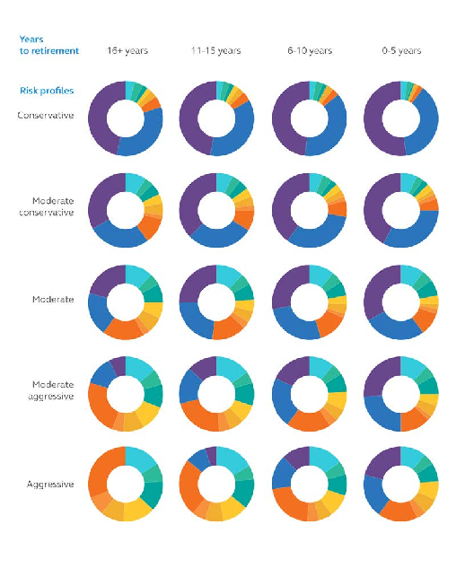
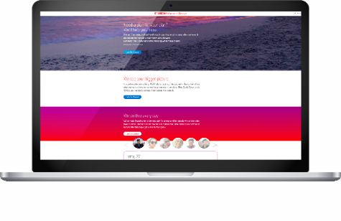
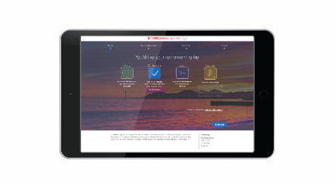
If you use Slide 9 of PQ12765F-2, you must also use slide 15
Let’s take a look at the details
Principal® EASE is a robust program with streamlined decisions for you:
An all-zero revenue sharing investment lineup selected by Wilshire
RetireView® asset allocation educational service (that takes risk tolerance and time-to-retirement into account)
Target My Retirement® managed accounts with personalized recommendations – powered by Morningstar Investment Management LLC
RetireView asset allocation model
For financial professional and plan sponsor use only.
PQ12765F-02 | 2924614-052023 | 05/2023
Notes:
Principal® EASE is a packaged, robust program with streamlined decisions for you, meaning more resources to help and less time spent on the details. The goal is to help more of your employees see a better retirement.
Let’s look at some of the key features/options of Principal® EASE.
First, tailored investment support…

Slide 10
If you use Slide 10 of PQ12765F-2, you must also use slide 15
Principal® EASE provides flexible options
Working closely with the guidance of your trusted financial professional:
Choose a QDIA eligible transition option
Add innovative options
Select key plan design features:
RetireView®
Principal target date series – with active/passive multi-management
Principal Pension BuilderSM – an in-plan guaranteed income option
Health Saving Account integration with Health Equity, HSA Bank or Optum*
Safe harbor or not
Eligibility and entry
Automated plan features
Contributions and vesting
*Health Equity, HSA Bank and Optum are not an affiliate of any company of the Principal Financial Group.
Principal does not make available products related to Health Savings Accounts.
For financial professional and plan sponsor use only.
PQ12765F-02 | 2924614-052023 | 05/2023
Notes:
And then additional flexibility for you to decide…

Slide 11
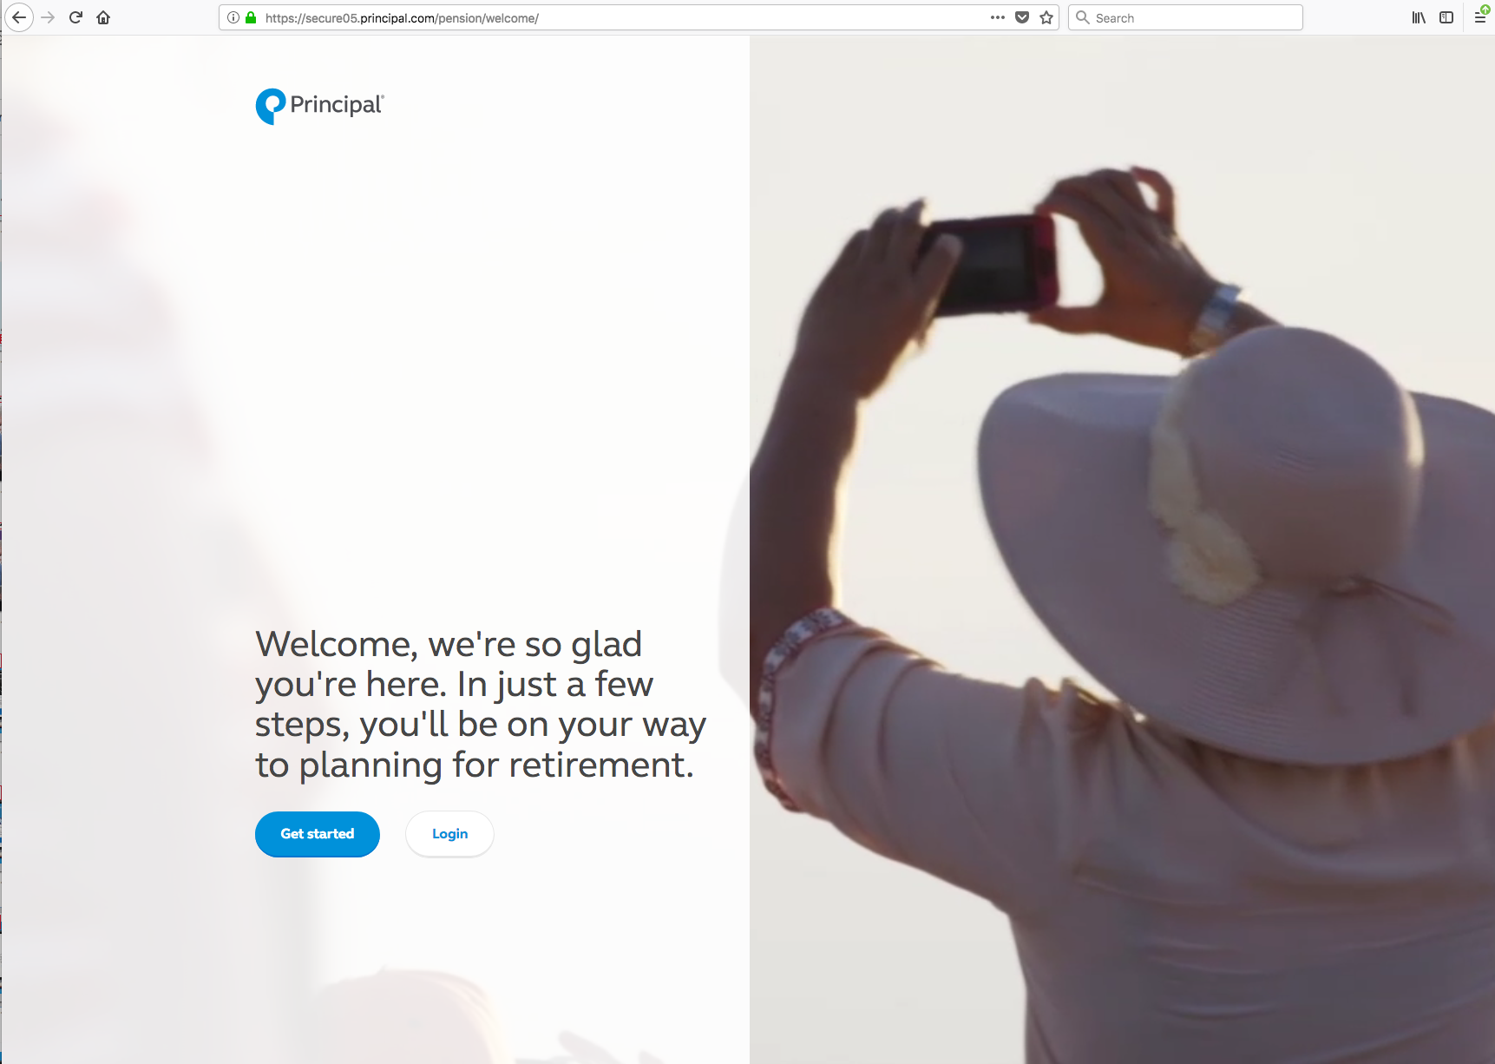
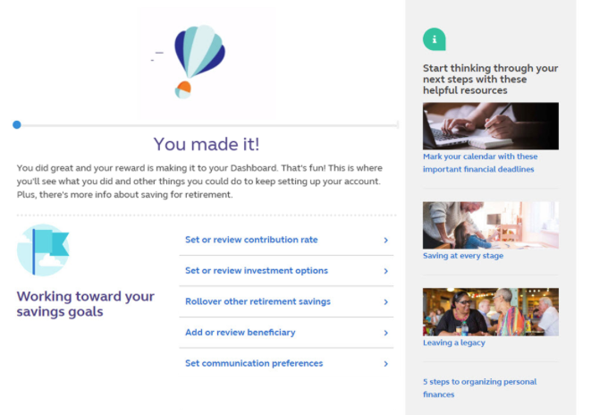
Slides 11-13 of PQ12765F-2 must remain together
Principal EASE®
For your 401(k) participants
Personalized to fit goals
PRINCIPAL® REAL START DIGITAL ONBOARDING EXPERIENCE – Gives eligible employees plan-specific help to get started.
Average deferral is more than 8%, with more than 1 in 3 participants auto-escalating their way up to 10%.*
Available in both English and Spanish
* Principal reporting as of Dec. 31, 2022.
For financial professional and plan sponsor use only.
PQ12765F-02 | 2924614-052023 | 05/2023
Notes:
Your employees will have access to an extensive array of onboarding services, educational resources, and more.
Principal® Real Start digital onboarding experience – Gives new and transitioning eligible employees plan-specific help to get started with contributions, investment elections, and more. Available in both English and Spanish.

Slide 12
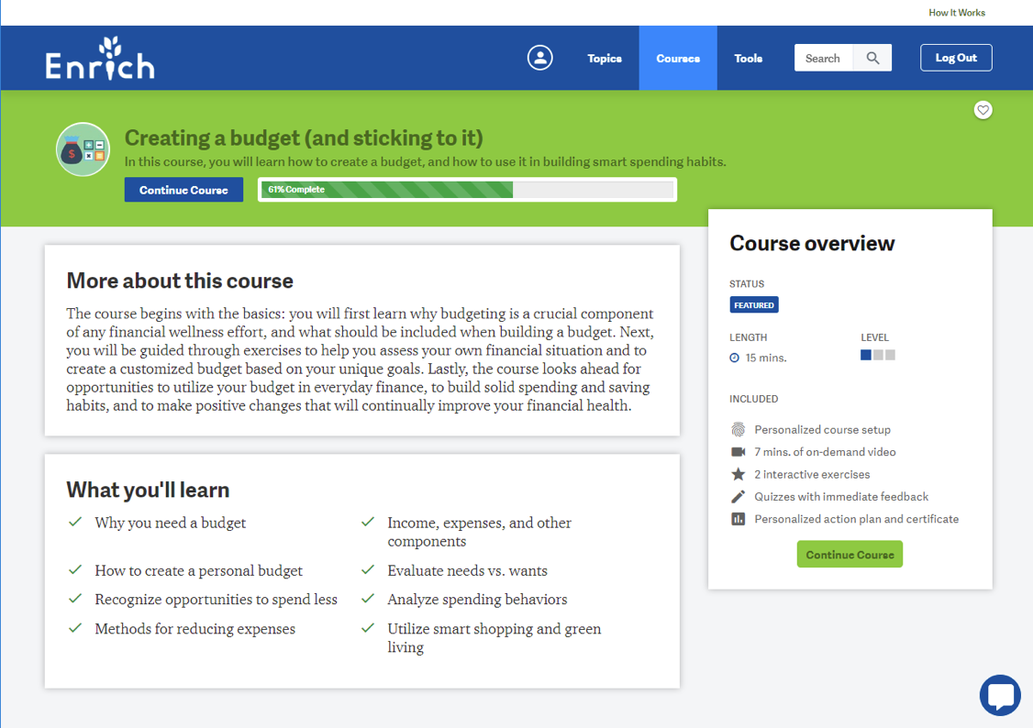
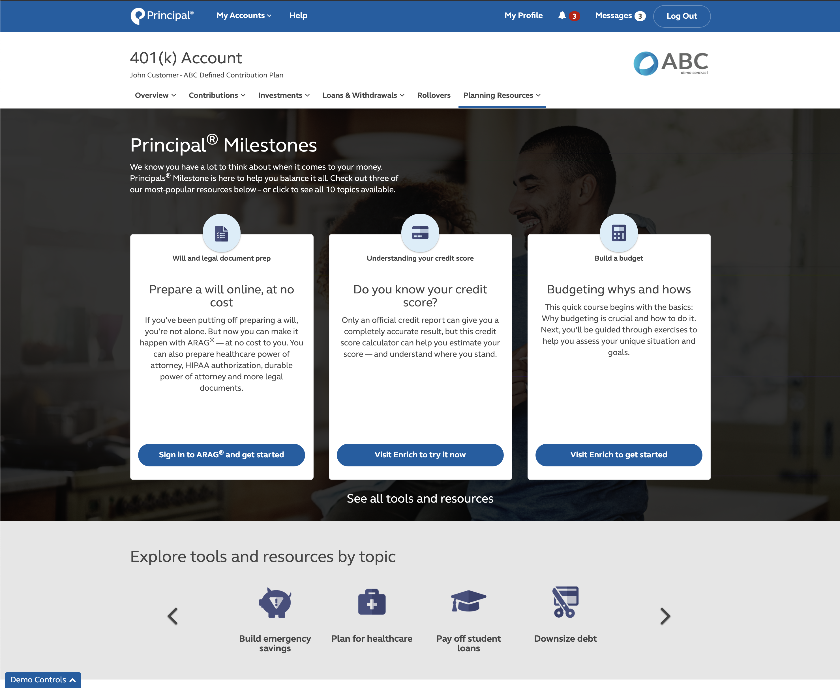
Slides 11-13 of PQ12765F-2 must remain together
Principal EASE®
For your 401(k) participants
Easy to build confidence
PRINCIPAL® MILESTONES –
Provides personalized, online education to help participants.
At no additional cost they can access:
On-demand digital content
Ability to prepare a will or other legal documents
Student loan repayment resources
Even find and apply for student scholarships
Average deferral is 38% higher for participants who use Principal® Milestones.*
More than 90,000
legal documents created.*
* Principal reporting as of Dec. 31, 2022.
The value-added resources provided through ARAG Services, LLC (ARAG®) and iGrad, Inc. (Enrich) are not a part of any insurance products and plan administrative services provided through Principal Life Insurance Co or affiliated with any company of the Principal Financial Group®. All resources may be changed or canceled at any time. The use of resources provided by ARAG Services, LLC or Enrich should not be considered a substitute for consultation with an attorney or advisor. Principal® is not responsible for any loss, injury, claim, liability, or damages related to the use of the ARAG Will & Legal Document Center or Enrich resources. Please remember that the ARAG legal documents are accurate and useful in many situations. Whether or not the document is right for you and your situation depends on your circumstances. If you want specific advice regarding your situation, consult an attorney.
For financial professional and plan sponsor use only.
PQ12765F-02 | 2924614-052023 | 05/2023
Notes:
Principal® Milestones—This financial wellness resource provides self-serve, personalized, online education to help participants increase knowledge and build their confidence.
At no additional cost they can access:
• On-demand digital meetings, including money management
• Access to prepare a will
• Student loan repayment resources
• Even find and apply for student scholarships

Slide 13
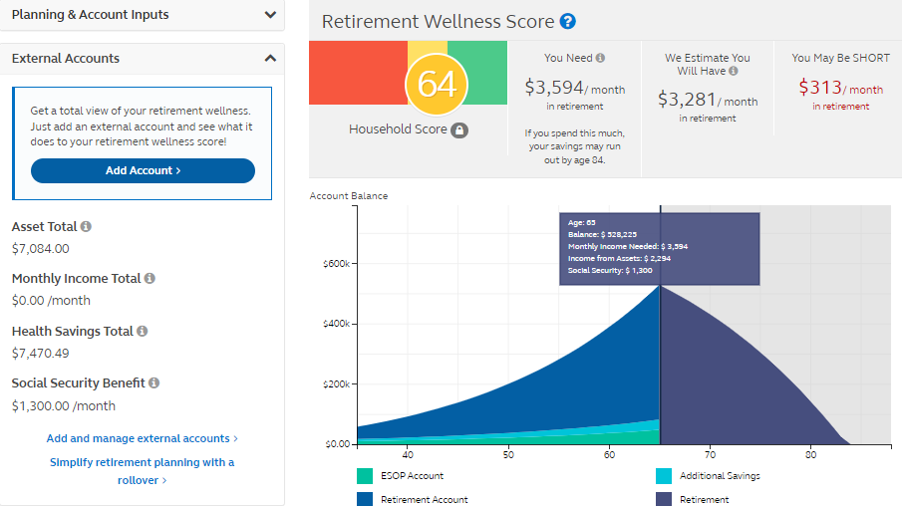
Slides 11-13 of PQ12765F-2 must remain together
Principal EASE®
For your 401(k) participants
Simple to take action
RETIREMENT WELLNESS SCORE –
Personalized to see how well they’re tracking toward their retirement goals.
EXTERNAL ACCOUNTS AGGREGATOR –
Participants get a more holistic picture
of their total Retirement Wellness Score by viewing the balances of all their retirement accounts in one place.
For illustrative purposes only.
The Retirement Wellness Planner information and Retirement Wellness Score are limited only to the inputs and other financial assumptions and is not intended to be a financial plan or investment advice from any company of the Principal Financial Group® or plan sponsor. This calculator only provides education which may be helpful in making personal financial decisions. Responsibility for those decisions is assumed by the participant, not the plan sponsor and not by any member of Principal®. Individual results will vary. Participants should regularly review their savings progress and post-retirement needs.
For financial professional and plan sponsor use only.
PQ12765F-02 | 2924614-052023 | 05/2023
Notes:
Retirement Wellness Score—A personalized score to see how well they’re tracking toward their retirement goals. The score represents the estimated percentage of their pre-retirement income they may be able to maintain at retirement
External accounts aggregator – By entering outside information related to assets, participants get a more holistic picture of their total Retirement Wellness Score. Once the account is linked, they can visit the planner to view the balances of all their retirement accounts in one place. If you offer your employees an HSA through HSA Bank®, HealthEquity®, or Optum Bank®, we can turn on even deeper integration.
If you offer your employees an HSA through HSA Bank®, HealthEquity®, or Optum Bank®, we can turn on even deeper integration.

Slide 14
How Principal protects you and your participants – and guarantees it
Principal has the people, processes, and technology in place to help safeguard access to your employees’ data and retirement savings.
Identity validation
Behavioral biometrics
Two-factor authentication
Acoustical analysis and phone printing
Account validation
Transaction updates
via text for notification
of fraudulent activity
Plus, we put in writing a Customer Protection Guarantee.*
* Employer-sponsored retirement plans are defined benefit or defined contribution. The guarantee applies to employer sponsored defined benefit, ESOP or defined contribution plans and is effective for unauthorized activity that occurs through no fault of their own. Exclusions to the policy may apply.
For financial professional and plan sponsor use only.
PQ12765F-02 | 2924614-052023 | 05/2023
Notes:
With the growing concern over cybersecurity, it’s important to assess the security processes of the service providers you work with.
Principal has the people, processes, and technology in place to help safeguard access to your employees’ data and retirement savings.
We are a fiduciary of the PEP as the Pooled Plan Provider. As Pooled Plan Provider of the PEP, we warrant that we will comply with ERISA’s fiduciary standards and all applicable laws.
Plus, we put in writing a Customer Protection Guarantee. It’s simple: Principal will reimburse participants’ employer-sponsored retirement accounts for losses from unauthorized activity through no fault of their own.

Slide 15
If you use Slide 9 or 10 of PQ12765F-2, you must also use slide 15
Morningstar Investment Management LLC is not an affiliate of any company of the Principal Financial Group.
RetireView® is an educational service designed to help retirement plan participants determine an appropriate investment mix for their retirement account. Principal retained Morningstar Investment Management LLC, a registered investment adviser and subsidiary of Morningstar, Inc., to create asset class-level model portfolios (“Models”) for RetireView. In no way should Morningstar Investment Management’s creation of the Models be viewed as advice or establishing any kind of advisory relationship with Morningstar Investment Management.
Morningstar Investment Management does not endorse and/or recommend any specific financial product that may be used in conjunction with the Models.
Equity investment options involve greater risk, including heightened volatility, than fixed-income investment options. Fixed-income investments are subject to interest rate risk; as interest rates rise their value will decline. International and global investment options are subject to additional risk due to fluctuating exchange rates, foreign accounting and financial policies, and other economic and political environments. Asset allocation does not ensure a profit or protect against a loss. Fixed-income and asset allocation investment options that invest in mortgage securities are subject to increased risk due to real estate exposure. Review the RetireView Terms and Conditions for a full discussion of the features of this service, including rebalancing and automatic age adjustment of the populated models.
Investing involves risk, including possible loss of principal.
Models are created by Morningstar Investment Management LLC. Morningstar Investment Management begins by analyzing asset classes and constructs long-term expected returns, standard deviations, and correlation coefficients. These form the inputs for the mean-variance optimization, a statistical technique. Because forecasting is a critical and pivotal step in the asset allocation process, Morningstar Investment Management develops proprietary capital market forecasts for each asset class using a combination of historical data, current market information and additional analysis. Each forecast becomes an input in portfolio creation. Models are intended to be used as an additional information source for retirement plan participants making investment allocation decisions. Pursuant to the Department of Labor’s Definition of Investment Education, such Models (taken alone or in conjunction with this document) do not constitute investment advice for purposes of the Employee Retirement Income Security Act (ERISA), and there is no agreement or understanding between Morningstar Investment Management and us or any plan or plan fiduciary, or any participant who uses this service, under which the latter receives information, recommendations or advice concerning investments that are to be used for any investment decisions relating to the plan. Accordingly, neither we nor Morningstar Investment Management are a fiduciary with respect to your plan sponsor’s plan for purposes of this service, including the features of rebalancing and aging. Following an asset allocation Model does not ensure a profit or protect against a loss. Performance of the individual Models may fluctuate and will be influenced by many factors. In applying particular asset allocation Models to their individual situations, participants or beneficiaries should consider their other assets, income and investments (e.g., equity in a home, Social Security benefits, IRA investments, savings accounts and interests in other qualified and nonqualified plans) in addition to their interests in the plan.
Target My Retirement is a managed account program that provides participants with a personalized approach to retirement planning and an investment strategy that moves on a glide path toward their retirement.
Principal has retained Morningstar Investment Management LLC as an investment adviser to create and manage the Target My Retirement investment strategies. Morningstar Investment Management uses its proprietary platform, Morningstar® Retirement ManagerSM to provide personalized advice on retirement age, savings rate, and investment strategies with the goal of helping a participant reach their retirement goals.
This service is offered by Morningstar Investment Management LLC, a registered investment adviser and subsidiary of Morningstar, Inc., and is intended for citizens or legal residents of the United States or its territories. Investment advice generated by this service is based on information provided and limited to the investment options available in the defined contribution plan. Projections and other information regarding the likelihood of various retirement income and/or investment outcomes are hypothetical in nature, do not reflect actual results, and are not guarantees of future results. Results may vary with each use and over time. The Morningstar name and logo are registered marks of Morningstar, Inc. Morningstar Investment Management is not affiliated with Principal.
Target My Retirement has been designed to be able to meet the requirements for a managed account “qualified default investment alternative” under DOL regulations. Note that plan specific requirements also apply. Plan sponsors should consult their legal advisors for more information.
The ability of Principal Life Insurance Company to pay the guarantee is based on the claims-paying ability of the general account and is subject to the terms of the contract.
Principal Pension BuilderSM is a deferred income annuity rider available through certain group annuity contracts with Principal Life Insurance Company, a member of the Principal Financial Group®, Des Moines, Iowa, 50392. Principal Pension Builder is not available to plan sponsor located in New York.
Principal Pension Builder provides for the purchase of deferred income annuities that provide guaranteed income in retirement. Contributions and transfers used to purchase guaranteed income through Principal Pension Builder will no longer be subject to market gains or losses. In exchange, the participant is purchasing a guaranteed future income stream. In no instance shall the Income Start Date be earlier than your Normal Retirement Date unless you separate from service prior to the plan’s Normal Retirement Date.
Guaranteed monthly income may change due to elections by the plan fiduciary or participant, such as changing the income start date or annuity form or surrendering guaranteed income. As an annuity, Principal Pension Builder does not have an investment performance, a management fee or expense ratio; those are concepts unique to investment products.
Information is intended to be educational in nature and is not intended to be taken as a recommendation.
Insurance products and plan administrative services provided through Principal Life Insurance Company®. Securities offered through Principal Securities, Inc., member SIPC and/or independent broker/dealers. Referenced companies are members of the Principal Financial Group®, Des Moines, IA 50392.
Certain investment options and contract riders may not be available in all states or U.S. commonwealths. Principal Global Investors leads global asset management and is a member of the Principal Financial Group®.
Principal®, Principal Financial Group®, and Principal and the logomark design are registered trademarks of Principal Financial Services, Inc., a Principal Financial Group company, in the United States and are trademarks and service marks of Principal Financial Services, Inc., in various countries around the world.
For financial professional and plan sponsor use only.
PQ12765F-02 | 2924614-052023 | 05/2023

